Slide 1
Project Presentation CS: 421 Natural Language Processing Automated Essay Grading with Neural Networks
Utsav Shah Karan Raghani December 2, 2019

Slide 2
Introduction
What is automated essay scoring (AES) ?
AES Challenge: ‘Automated Student Assessment Prize’

Slide 3
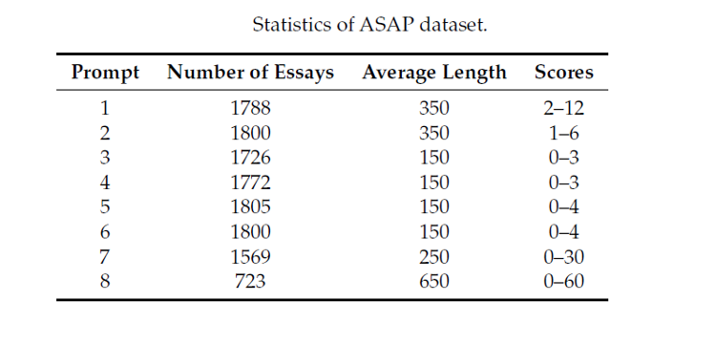
Data Set
10% for testing, 10% for validation and the other 80% was used for training.

Slide 4
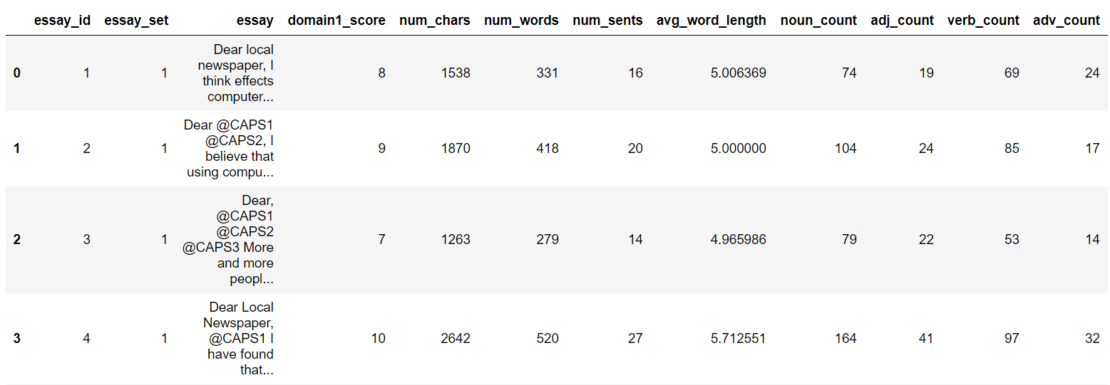
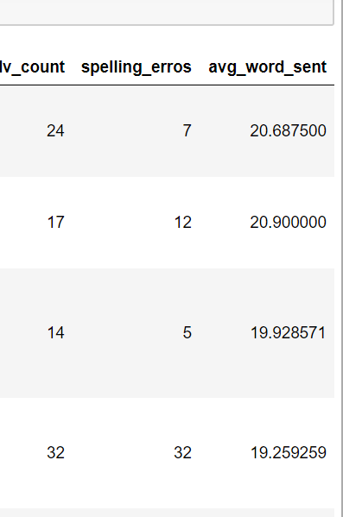
Data

Slide 5
Features Extraction
Word Count
Number of Characters
Number of Sentences
Average Word Length
Average number of words in a sentence
Noun Count
Adjective Count
Verb Count
Adverb Count
Spell Check
First nine features are extracted using NLTK and python
Spell Check is implemented using PySpellChecker.

Slide 6
Word Embedding
GloVe is used to generate word vectors
The GLoVe word vectors of all the word in an essay, average them to get the essay vector.
We experimented with GLoVe word vectors with a dimension of 300.

Slide 7
Evaluation
Quadratic Weighted Kappa used as Evaluation Metric for this project.
Kappa is calculated between the automated generated scores for the essays against the resolved scores of human raters.
Kappa Value ranges from 0 to 1.

Slide 8
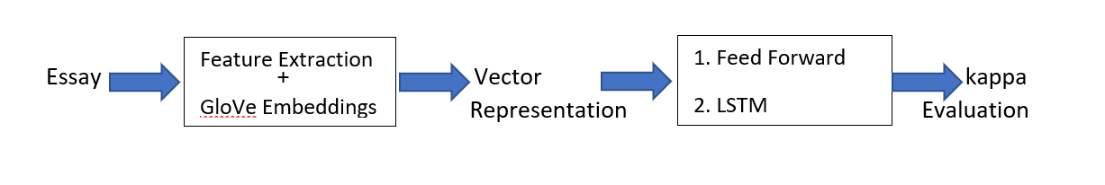
Implementations
Model | Word Vector
2 – Layer NN | Features only
4 – Layer NN | GloVe
4 – Layer NN | GloVe+ Features
LTSM | GloVe

Slide 9
Feed Forward Network
Implemented with Tensorflow & Keras Parameters :
• The number of epoch: 300 - 800
• Validation and testing percentage: 0.2
• Function used for avoiding over-fitting: dropout
• Activation function: sigmoid/tanh function
• Loss function: mean squared error
• Optimize function: rmsprop

Slide 10
LSTM
Implemented with Tensorflow & Keras Parameters :
• The number of epoch: 500
• Validation and testing percentage: 0.2
• Function used for avoiding over-fitting: dropout
• Activation function: sigmoid/tanh function
• Loss function: mean squared error
• Optimize function: rmsprop

Slide 11
Results
Model | Word Vector | Kappa
2 – Layer NN | Features only | ~0.7812
4 – Layer NN | GloVe | ~0.7173
4 – Layer NN | GloVe+ Features | ~0.7886
LTSM | GloVe | ~0.701
The models were trained and evaluated on Set 1 of the essays.

Slide 12
Thank You

